Slide 1
NP Hard Problems
Instructor
Neelima Gupta
ngupta@cs.du.ac.in
Presentation Edited by Sapna Grover

Slide 2
Table of Contents
NP – Hardness
Reductions

Slide 3
NP - Hard
The aim to study this class is not to solve a problem but to see how hard the problem is?

Slide 4
Reduction
The crux of NP-Hardness is reducibility
We say that a problem P is reduced to another problem Q if an instance of P can be easily transformed into an instance of Q, the solution to which provides a solution to the instance of P.
Intuitively it means that if one can solve Q then one can solve P also, i.e. P is “no harder to solve” than Q or Q is at least as hard as P.

Slide 5
Poly. Time
I_{P}
I_{Q}
I_{P} : Instance of problem P
I_{Q} : Instance of problem Q
S_{P} : Solution of problem P
S_{Q} : Solution of problem Q
Poly. Time
S_{P}
(Yes/No)
S_{Q}
(Yes/No)

Slide 6
Transformation Characterstics
If A(Q) is yes then A(P) is yes
Vice versa
It should be done in polynomial time

Slide 7
Reducibility
An example:
P: Given a set of Booleans, is at least one TRUE?
Q: Given a set of integers, is their sum positive?
Transformation: (x₁, x₂, …, x_{n}) = (y₁, y₂, …, y_{n}) where y_{i} = 1 if x_{i} = TRUE, y_{i} = 0 if x_{i} = FALSE
Another example:
Solving linear equations is reducible to solving quadratic equations
How can we easily use a quadratic-equation solver to solve linear equations?

Slide 8
NP hard
Q is s.t.b. NP-hard if ∀ P ∈ NP, P ≤_{p} Q
Poly. Time
I_{P}
I_{Q}
I_{P} : Instance of problem P
I_{Q} : Instance of problem Q
S_{P} : Solution of problem P
S_{Q} : Solution of problem Q
Poly. Time
S_{P}
(Yes/No)
S_{Q}
(Yes/No)

Slide 9
If all problems R ∈ NP are reducible to T, then T is NP-Hard
T
is NP hard

Slide 10
If T is NP-Hard
And T ∈ NP then T is NPC.
T
NPC
Q
NP
If T ≤_{p} Q then Q is NP hard.

Slide 11
Diagrammatically
NP HARD
NPC

Slide 12
The SAT Problem
One of the first problems proved to be NP-Hard was satisfiability (SAT):
Given a Boolean expression on n variables, can we assign values such that the expression is TRUE?
Ex: ((x₁ →x₂) ∨ ¬((¬x₁ ↔ x₃) ∨ x₄)) ∧¬x₂
Cook’s Theorem: The satisfiability problem is NP-Hard (actually NP Complete…will do this later)
Note: Argue from first principles, not reduction
Proof: not here

Slide 13
Conjunctive Normal Form
Even if the form of the Boolean expression is simplified, the problem is NP-Hard (NP Complete)
Literal: an occurrence of a Boolean or its negation
A Boolean formula is in conjunctive normal form, or CNF, if it is an AND of clauses, each of which is an OR of literals
Ex: (x₁ ∨ ¬x₂) ∧ (¬x₁ ∨ x₃ ∨ x₄) ∧ (¬x₅)
3-CNF: each clause has exactly 3 distinct literals
Ex: (x₁ ∨ ¬x₂ ∨ ¬x₃) ∧ (¬x₁ ∨ x₃ ∨ x₄) ∧ (¬x₅ ∨ x₃ ∨ x₄)
Notice: true if at least one literal in each clause is true

Slide 14
The 3-CNF Problem
Thm 36.10: Satisfiability of Boolean formulas in 3-CNF form (the 3-CNF Problem) is NP-Hard (NP-Complete)
Proof: Nope
The reason we care about the 3-CNF problem is that it is relatively easy to reduce to others
Thus by proving 3-CNF NP-Hard we can prove many seemingly unrelated problems NP-Hard

Slide 15
CLIQUE is NP Hard
Pick up a problem known to be NPHard and
Transform (reduce) the known problem to CLIQUE
0 Give the transformation
Show that under the transformation : solution of known problem is yes => solution to CLIQUE is yes.
Show that under the transformation : solution of CLIQUE is yes => solution of the known problem is yes.
Show that the transformation can be done in time polynomial in the length of an instance of the known problem.
SO, THREE STEPS TO REDUCE A KNOWN PROBLEM TO CLIQUE.

Slide 16
3-CNF → Clique
What should the reduction do?
A: Transform a 3-CNF formula to a graph, for which a k-clique will exist (for some k) iff the 3-CNF formula is satisfiable.

Slide 17
3-CNF → Clique
The reduction:
Let B = C₁ ∧ C₂ ∧ … ∧ C_{k} be a 3-CNF formula with k clauses, each of which has 3 distinct literals
For each clause put a triple of vertices in the graph, one for each literal
Put an edge between two vertices if they are in different triples and their literals are consistent, meaning not each other’s negation

Slide 18
Let the expression in 3CNF be: (~x v y v z) ^ (x v ~y v ~z) ^ (x v y v z)
Expression → Graph
~x y z
x
y
z
x
~y
~z

Slide 19
Clique thus formed:
y
x
z
Note:- There are many other possible cliques in previous mapping. This is one of the possible cliques.

Slide 20
3-CNF → Clique
Prove the reduction works:
If B has a satisfying assignment, then each clause has at least one literal (vertex) that evaluates to 1
Picking one such “true” literal from each clause gives a set V’ of k vertices. V’ is a clique (Why?)
If G has a clique V’ of size k, it must contain one vertex in each triple (clause) (Why?)
We can assign 1 to each literal corresponding with a vertex in V’, without fear of contradiction

Slide 21
Reduction takes polynomial time
Let there be n variables in the 3-CNF with k clauses
Then, the input size is theta(k + n).
Size of the graph = 3k*3(k-1)

Slide 22
Vertex Cover is NP-Hard
Pick up a problem known in NP-hard
CLIQUE

Slide 23
Clique ≤_{p} Vertex Cover
Let the instance of Clique ( I_{c}) be <G, k>.
Reducing it to instance of VC (I_{vc}) be <G’, |V|-k>
where G’ : E(G’)=Edges b/w vertex pair not present in G and |V|-k is the vertex cover.
Catch behind this choice : Because it works…!!!

Slide 24
G
Green ovals represent CLIQUE for this graph

Slide 25
G
G’

Slide 26
G
G’
Big ovals represent the VC for graph G’

Slide 27
Clique → Vertex Cover
Reduce k-clique to vertex cover
The complement G_{C} of a graph G contains exactly those edges not in G
Compute G_{C} in polynomial time
G has a clique of size k iff G_{C} has a vertex cover of size |V| - k

Slide 28
Clique → Vertex Cover
Claim: If G has a clique of size k, G_{C} has a vertex cover of size |V| - k
Let V’ be the k-clique
Then V - V’ is a vertex cover in G_{C}
Let (u,v) be any edge in G_{C}
Then u and v cannot both be in V’ (Why?)
Thus at least one of u or v is in V-V’ (why?), so edge (u, v) is covered by V-V’
Since true for any edge in G_{C}, V-V’ is a vertex cover

Slide 29
Clique → Vertex Cover
Claim: If G_{C} has a vertex cover V’ ⊆ V, with |V’| = |V| - k, then G has a clique of size k
For all u,v ∈ V, if (u,v) ∈ G_{C} then u ∈ V’ or v ∈ V’ or both (Why?)
Contrapositive: if u ∉ V’ and v ∉ V’, then (u,v) ∈ E
In other words, all vertices in V-V’ are connected by an edge, thus V-V’ is a clique
Since |V| - |V’| = k, the size of the clique is k

Slide 30
Independent Set Problem
Independent Set : A subset S of V is said to be independent if no 2 nodes in S are joined by an edge.
Problem Statement: Given a graph G=(V,E), find an independent set that is as large as possible.
Notes:
References: 1. Kleinberg and Tardos

Slide 31
Exercise
Show that Independent Set is NP Hard by reducing it from
3 CNF
Clique
Vertex Cover
Show that Vertex Cover is NP Hard by reducing it from
3 CNF

Slide 32
Subset Sum Problem
Problem Statement
Given: A finite set S of natural numbers.
A target t є N.
To Find: If there exists a subset S’ of S whose elements sum up to t.
Notes:
References: Cormen

Slide 33
Subset Sum Problem
We now prove that Subset Sum Problem is
NP-Complete.
Subset Sum is in NP. For an instance <S,t>, let S’ be the certificate. Checking whether elements of S’ sum to t can be done in polynomial time.

Slide 34
Subset Sum Problem
Subset Sum is NP Hard
We show this by proving that 3-SAT is reducible
to Subset Sum in polynomial time.
Given: 3-SAT formula Ф over variables x₁, x₂, ……x_{n}
with clauses C₁, C₂……C_{k}

Slide 35
Subset Sum Problem
Without loss of generality, we make the
following 2 assumptions:
No clause contains both a variable and its negation. WHY?
(Because such a clause would be trivially satisfied.)
Each variable appears in at least 1 clause. WHY?
(Because otherwise, it does not matter what value is assigned to it.)

Slide 36
Subset Sum Problem
Reduction Process - through example
Consider the 3-SAT formula : Ф = C₁^ C₂ ^ C₃ ^ C₄
where C₁ =(x₁ v x₂’ v x₃’)
C₂ =(x₁’ v x₂’ v x₃’)
C₃ =(x₁’ v x₂’ v x₃)
C₄ =(x₁ v x₂ v x₃)
A satisfying assignment is <x₁=0, x₂=0, x₃=1>

Slide 37
Subset Sum Problem
Steps:
Create 2 numbers in set S for each variable x_{i} and 2 numbers for each clause C_{j}.
These numbers are in base 10 and each has n+k digits.
Each digit corresponds to a variable or a clause. Label least significant k digits by clauses and most significant n digits by variables.

Slide 38
Subset Sum Problem
Do the following for i = 1……n
If xi = 1 in the assignment, include v_{i} in S’, otherwise include v_{i}’. In the example,
x1=0 => x1’=1 , v₁’ is selected
x2=0 => x2’=1 , v₂’ is selected
x3=1 => x3=1 , v₃ is selected

Slide 39
(x1 v x2’ v x3’) Λ (x1’ v x2’ v x3’) Λ (x1’ v x2’ v x3) Λ (x1 v x2 v x3)
Satisfying assignment x1=0, x2=0, x3=1
x₁’, x₂’ and x₃ are selected.
X1
X2
X3
C1
C2
C3
C4
V1
1
0
0
1
0
0
1
V1'
1
0
0
0
1
1
0
V2
0
1
0
0
0
0
1
V2'
0
1
0
1
1
1
0
V3
0
0
1
0
0
1
1
V3'
0
0
1
1
1
0
0
S1
0
0
0
1
0
0
0
S1'
0
0
0
2
0
0
0
S2
0
0
0
0
1
0
0
S2'
0
0
0
0
2
0
0
S3
0
0
0
0
0
1
0
S3'
0
0
0
0
0
2
0
S4
0
0
0
0
0
0
1
S4'
0
0
0
0
0
0
2
t
1
1
1
4
4
4
4

Slide 40
(x1 v x2’ v x3’) Λ (x1’ v x2’ v x3’) Λ (x1’ v x2’ v x3) Λ (x1 v x2 v x3)
Satisfying assignment x1=0, x2=0, x3=1
X1
X2
X3
C1
C2
C3
C4
V1
1
0
0
1
0
0
1
V1'
1
0
0
0
1
1
0
V2
0
1
0
0
0
0
1
V2'
0
1
0
1
1
1
0
V3
0
0
1
0
0
1
1
V3'
0
0
1
1
1
0
0
S1
0
0
0
1
0
0
0
S1'
0
0
0
2
0
0
0
S2
0
0
0
0
1
0
0
S2'
0
0
0
0
2
0
0
S3
0
0
0
0
0
1
0
S3'
0
0
0
0
0
2
0
S4
0
0
0
0
0
0
1
S4'
0
0
0
0
0
0
2
t
1
1
1
4
4
40
4
4

Slide 41
(x1 v x2’ v x3’) Λ (x1’ v x2’ v x3’) Λ (x1’ v x2’ v x3) Λ (x1 v x2 v x3)
Satisfying assignment x1=0, x2=0, x3=1
X1
X2
X3
C1
C2
C3
C4
V1
1
0
0
1
0
0
1
V1'
1
0
0
0
1
1
0
V2
0
1
0
0
0
0
1
V2'
0
1
0
1
1
1
0
V3
0
0
1
0
0
1
1
V3'
0
0
1
1
1
0
0
S1
0
0
0
1
0
0
0
S1'
0
0
0
2
0
0
0
S2
0
0
0
0
1
0
0
S2'
0
0
0
0
2
0
0
S3
0
0
0
0
0
1
0
S3'
0
0
0
0
0
2
0
S4
0
0
0
0
0
0
1
S4'
0
0
0
0
0
0
2
t
1
1
1
4
4
41
4
4

Slide 42
(x1 v x2’ v x3’) Λ (x1’ v x2’ v x3’) Λ (x1’ v x2’ v x3) Λ (x1 v x2 v x3)
Satisfying assignment x1=0, x2=0, x3=1
X1
X2
X3
C1
C2
C3
C4
V1
1
0
0
1
0
0
1
V1'
1
0
0
0
1
1
0
V2
0
1
0
0
0
0
1
V2'
0
1
0
1
1
1
0
V3
0
0
1
0
0
1
1
V3'
0
0
1
1
1
0
0
S1
0
0
0
1
0
0
0
S1'
0
0
0
2
0
0
0
S2
0
0
0
0
1
0
0
S2'
0
0
0
0
2
0
0
S3
0
0
0
0
0
1
0
S3'
0
0
0
0
0
2
0
S4
0
0
0
0
0
0
1
S4'
0
0
0
0
0
0
2
t
1
1
1
4
4
42
4
4

Slide 43
(x1 v x2’ v x3’) Λ (x1’ v x2’ v x3’) Λ (x1’ v x2’ v x3) Λ (x1 v x2 v x3)
Satisfying assignment x1=0, x2=0, x3=1
X1
X2
X3
C1
C2
C3
C4
V1
1
0
0
1
0
0
1
V1'
1
0
0
0
1
1
0
V2
0
1
0
0
0
0
1
V2'
0
1
0
1
1
1
0
V3
0
0
1
0
0
1
1
V3'
0
0
1
1
1
0
0
S1
0
0
0
1
0
0
0
S1'
0
0
0
2
0
0
0
S2
0
0
0
0
1
0
0
S2'
0
0
0
0
2
0
0
S3
0
0
0
0
0
1
0
S3'
0
0
0
0
0
2
0
S4
0
0
0
0
0
0
1
S4'
0
0
0
0
0
0
2
t
1
1
1
4
4
43
4
4

Slide 44
Subset Sum Problem
Construct S and t as follows:
t has a 1 in each digit labeled by a variable and 4 in each clause-digit.
For each x_{i}, there exist 2 integers v_{i}, v_{i}’ in S. Both v_{i} and v_{i}’ have 1 corresponding to digit x_{i}.
If x_{i} appears in C_{j}, the C_{j}-digit in v_{i} = 1
If v_{i}’ appears in C_{j}, the C_{j}-digit in v_{i}’ = 1
All other digits are zero.

Slide 45
Subset Sum Problem
Claim: All v_{i} and v_{i}’ in S are unique
v_{i} (v_{i}’) and v_{j} (v_{j}’ ) will be different in most significant positions.
v_{i} and v_{i}’ will be different in least significant positions. WHY?
(both cannot belong to the same clause)

Slide 46
Subset Sum Problem
For all C_{j}, there exist s_{j} and s_{j}’ integers in S. Both have 0’s in all digits other than the one labeled by C_{j}.
s_{j} has a 1 corresponding to C_{j}, and s_{j}’ has a 2 corresponding to C_{j}.
These integers are slack variables, used to get clause labeled digit position to add to the target value of 4.

Slide 47
Subset Sum Problem
Claim: All s_{j} and s_{j}’ in S are unique
(for reasons similar to v_{i} and v_{i}’)
Observation: The greatest sum of digits in any digit position is 6. This occurs in clause-digits (v_{i} and v_{i}’ make a contribution of 3, s_{j} and s_{j}’ make a contribution of 1 and 2 respectively).
Conclusion: Interpretation is in base 10, so no carries would be generated.
REDUCTION DONE !!

Slide 48
Subset Sum Problem
Claim: This reduction can be done in polynomial time.
S contains 2n+2k values.
Each has n+k digits.
Each digit takes time polynomial in (n+k) to be produced.
t has n+k digits each being produced in constant time.
Hence Proved !

Slide 49
Subset Sum Problem
To Prove: 3-SAT Ф is satisfiable if and only if there exists a subset S’ of S whose elements sum to ‘t’.
Proof
Part 1
Given: Ф has a satisfying assignment.

Slide 50
Subset Sum Problem
Do the following for i = 1……n
If x_{i} = 1 in the assignment, include v_{i} in S’, otherwise include v_{i}’. In the example, v₁’, v₂’, v₃ belong to S’.
Note: For each variable digit, the sum of values of S’ must be 1 ( = those of target t)

Slide 51
Subset Sum Problem
Each clause is satisfied, therefore has at least one positive literal. Thus, each clause digit has at least one ‘1’ through a vi or vi’ value in S’. (the sum of clause digit may be 1 or 2 or 3).
Include appropriate non empty subset of slack variables {s_{j}, s_{j}’} in S’ to achieve the target of 4 in each digit labeled by C_{j}.

Slide 52
Subset Sum Problem
Since we have matched all target digits of the sum, and there does not exist any carry, therefore the values of S’ sum to t.

Slide 53
Subset Sum Problem
Part 2 of the proof
Given: Subset S’ of S sums to t.
Observe the following:
S’ must include exactly one of v_{i} and v_{i}’ for all i. WHY?
Because otherwise variable digits would not sum to 1

Slide 54
Subset Sum Problem
If v_{i} belongs to S’, set x_{i} = 1.
If v_{i}’ belongs to S’, set x_{i}’ = 0.
Claim: Every clause C_{j} is satisfied by this assignment.
Proof: Note that in order to achieve a sum of in
digits corresponding to Cj, the subset S’ must
include at least one vi or vi’ value that has a value
1 in the digit labeled by Cj.

Slide 55
Subset Sum Problem
Since we have xi =1 if vi belongs to S’, clause Cj is satisfied.
And since xi =0 if vi’ belongs to S’, again clause Cj is satisfied.
Therefore, all clauses are satisfied.
Hence Proved !

Slide 56
Set Cover Problem
Problem Statement
Given
A set U of n elements
A collection S₁, S₂,……., S_{m} of subsets of U
A number k
To Find If there exists a collection of at most k of these sets whose union equals all of U.

Slide 57
Set Cover Problem
An Application
Suppose we want to build a system with n functionalities using m available pieces of software.
Each piece of software possesses some subset of functionalities. Let the set of functionalities possessed by the i^{th} piece of software be denoted by S_{i}.
Our goal, then, is to build a system that possesses all the n functionalities using a small number of pieces of software.

Slide 58
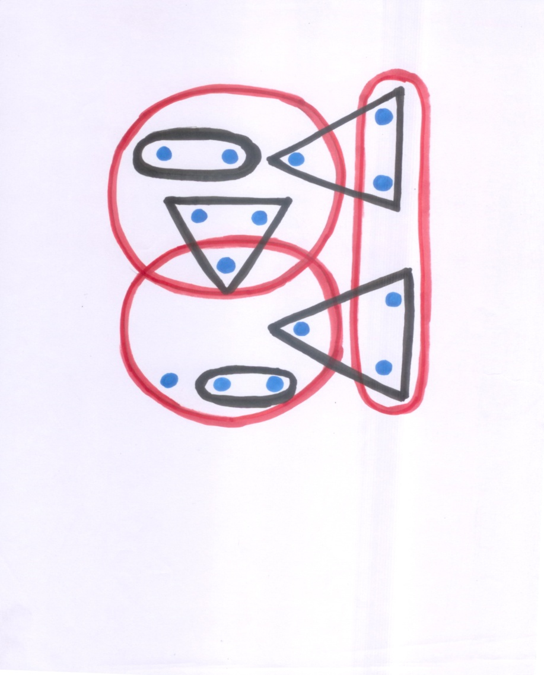
Set Cover Problem
An Instance
The little blue dots are the elements of U
Black and Red figures represent sets. The dots that lie within a figure are the elements contained by that set.
The red figure form the set cover.

Slide 59
Set Cover Problem is NP Complete
Prove that it is in NP
NP – hardness follows from reduction from vertex cover. HOW?......Assignment

Slide 60
(Metric) Traveling Salesman Problem
Problem Statement
Given A complete graph G with non-
negative edge costs ( that satisfy
triangle inequality)
To Find A minimum cost cycle visiting
every vertex exactly once.
Decision Version: Does there exist a TS tour of cost <=k

Slide 61
TSP is NP Complete
Prove that it is in NP
NP – hardness follows from reduction from Hamiltonian Cycle. HOW? Assignment.

Slide 62
NP-Complete Problems
The NP-Complete problems are an interesting class of problems whose status is unknown
No polynomial-time algorithm has been discovered for an NP-Complete problem
No supra-polynomial lower bound has been proved for any NP-Complete problem, either
We call this the P = NP question
The biggest open problem in CS

Slide 63
NP-Completeness
The space NP of all search problems, assuming P ≠ NP
P NPC
INCREASING DIFFICULTY

Slide 64
Significance of NP-Completeness
The interest surrounding the class of NP-complete problems can be attributed to the following reasons.
No polynomial-time algorithm has yet been discovered for any NP-complete problem; at the same time no NP-complete problem has been shown to have a super polynomial-time (for example exponential time) lower bound.
If a polynomial-time algorithm is discovered for even one NP-complete problem, then all NP-complete problems will be solvable in polynomial-time.
It is believed (but so far no proof is available) that NP-complete problems do not have polynomial-time algorithms and therefore are intractable. The basis for this belief is the second fact above, namely that if any single NP-complete problem can be solved in polynomial time, then every NP-complete problem has a polynomial-time algorithm.
Given the wide range of NP-complete problems that have been discovered to date, it will be sensational if all of them could be solved in polynomial time.

Slide 65
Why Prove NP-Completeness?
Though nobody has proved that P != NP, if you prove a problem NP-Complete, most people accept that it is probably intractable
Therefore it can be important to prove that a problem is NP-Complete
Don’t need to come up with an efficient algorithm
Can instead work on approximation algorithms

Slide 66
Acknowledgment
Shivam Sharma
Sufyan Haroon

Slide 67
Any Questions….

Slide 68
UP Next
Approximation Algorithms

